Slide 1





Deformation of Cu-Pd-P metallic glass under cyclic mechanical load on continuous heating
A.D. Bereznerª, V.A. Fedorovª, M.Yu. Zadorozhnyy^{b},
I.S. Golovin^{b}, D.V. Louzguine-Luzgin^{c,d}
ªDerzhavin Tambov State University,
392000, Internatsionalnaya str. 33, Tambov, Russia
^{b}National University of Science and Technology «MISIS»,
119049, Leninsky Avenue 4, Moscow, Russia
^{c}WPI Advanced Institute for Materials Research, Tohoku University, Aoba-Ku, Sendai 980-8577, Japan
^{d}Mathematics for Advanced Materials-OIL, National Institute of Advanced Industrial Science and Technology (AIST), Sendai 980-8577, Japan

Slide 2
The main goal is a model and experimental investigation of plastic flow of Co-based amorphous alloy on variable heating under dynamic (periodical) loading.
The tasks:
Suggestion and verification of the model function for deformation;
Variation of the loading frequency at the same rate of heating;
Derivation of the main relationship in frames of Newton’s laws of motion;
Further conclusions from the results;

Slide 3
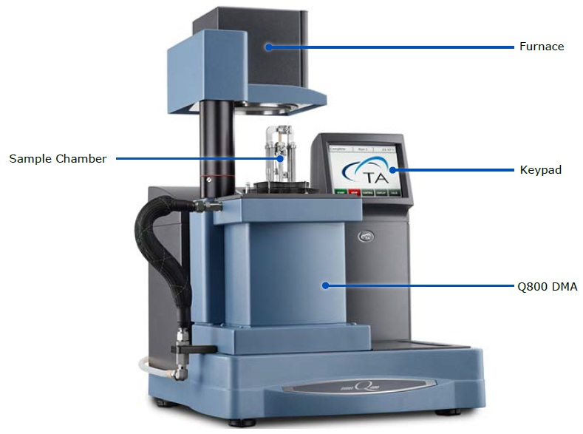
Materials and Methods
Samples: Cu₅₄Pd₂₈P₁₈ alloy of 30 mm (length), 2.5 mm (wide), 0.025 mm (thickness).
Structure testing: Cu-Kα X-ray diffractometry.
Temperature stability: DSC at 5 K/min., 528 K and 568 К are glass-transition (Tg) and crystallization temperatures, respectively.
Dynamic mechanical analysis (DMA): a specimen with 18.5 mm working zone,
Q800 (TA Instruments), heating at 5 K/min., oscillation mode at 20 kPa amplitude and 0.3 Hz - 3 Hz frequencies. Preloading conditions are 20 MPa.
Figure 1. General view of the working equipment
(Q800 analyzer)

Slide 4
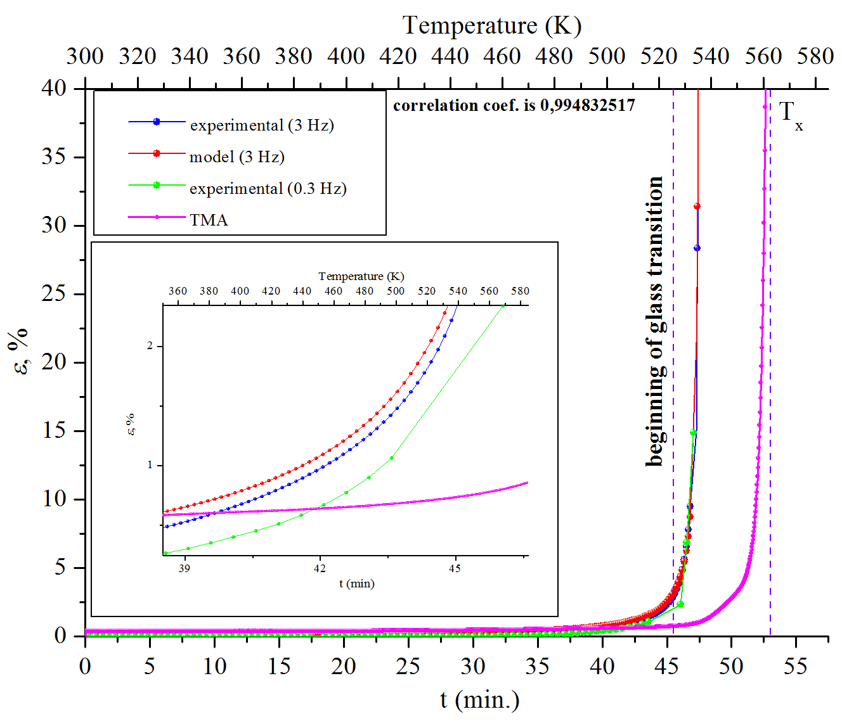
Results and Discussion
(1)
l₀ – is initial length; С and B – are analytical fixed parameters having [m·s] and [s] units, respectively.
B – parameter is time of the fracture of a specimen; t – current deformation time and C – is a deformational coefficient of material.
(2)
T₀ and T – the initial and current temperatures of heating;
V_{T} – the heating rate.
Figure 2. Experimental and analytical relations of the elongation of a specimen as a function of time and temperature

Slide 5
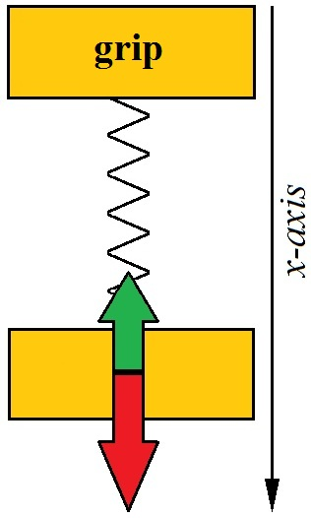
(3)
m – is mass of the material point (the machine grip), – acceleration of the material point,
F_{load} – constant external load from the testing machine, A – amplitude of external additional (load) oscillations, ω – angular frequency of oscillations (2π·3 Hz equals to 6π rad/s), F_{reaction} – reaction force of the amorphous specimen (the spring).
Figure 3. Scheme of loading: Loading direction is indicated with the red arrow and the reaction force is depicted with the green arrow
(4)
(5)
(6)

Slide 6
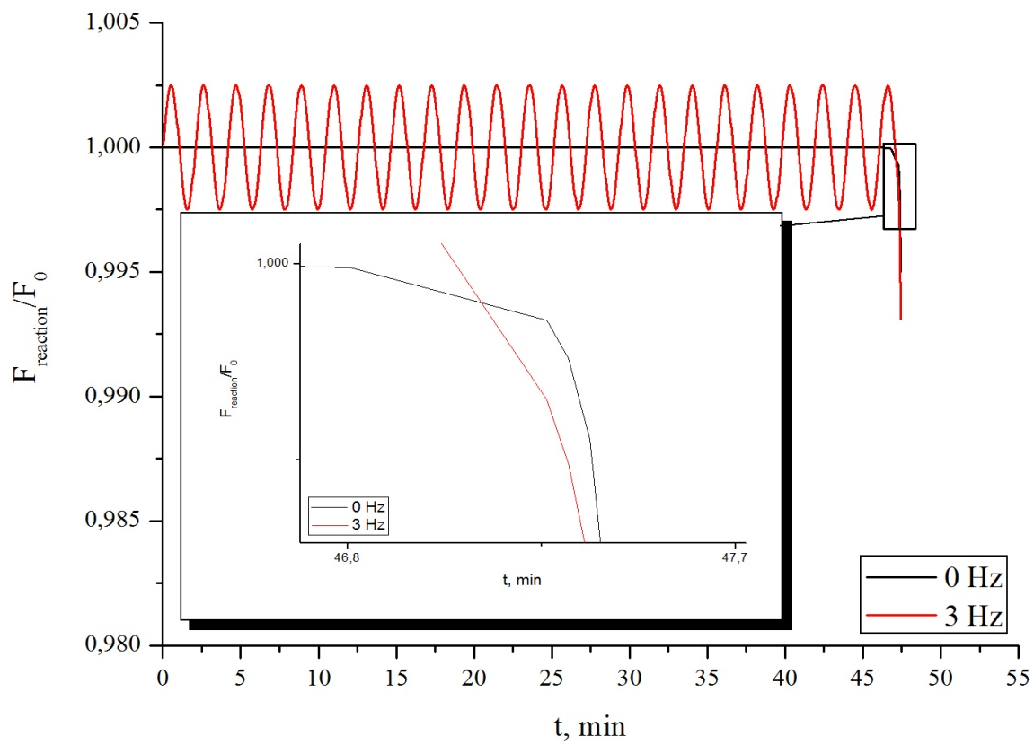
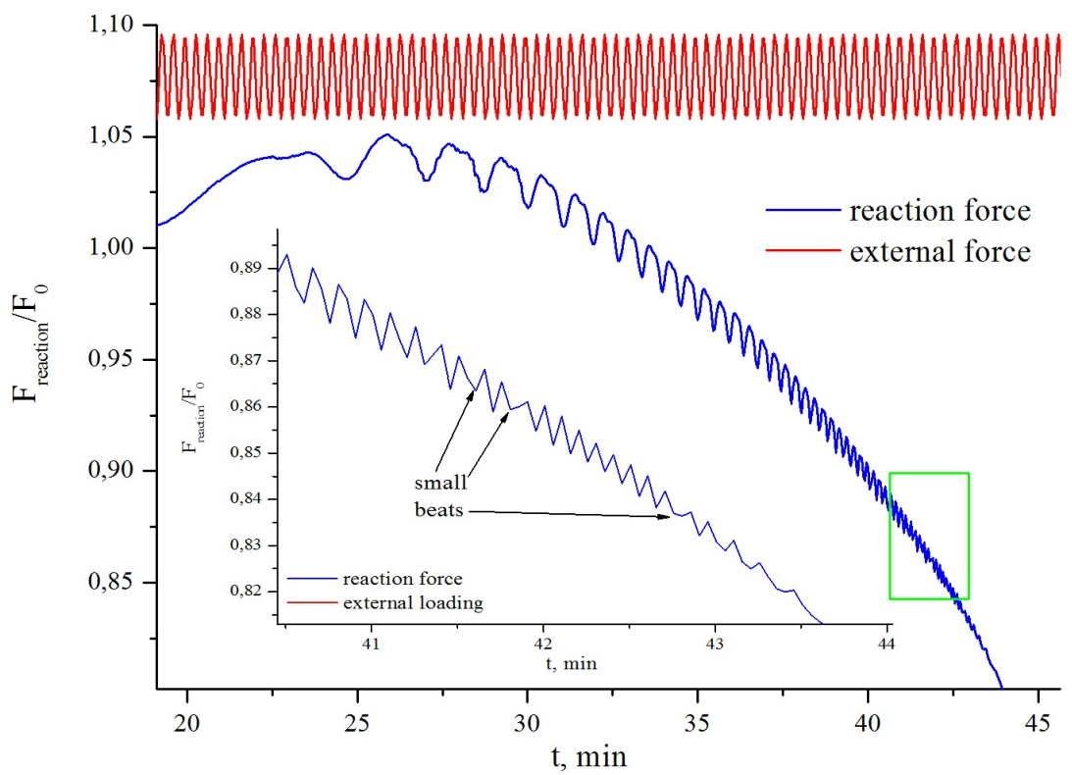
a)
Figure 4. a) The calculated relations of reaction force F(t)/F0 of the specimen: with the cyclic load – the orange line and without it – the black marker.
b) An experimental graph
,
b)
(7)

Slide 7
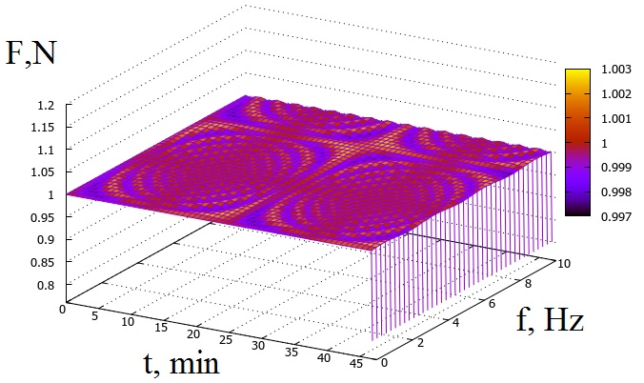
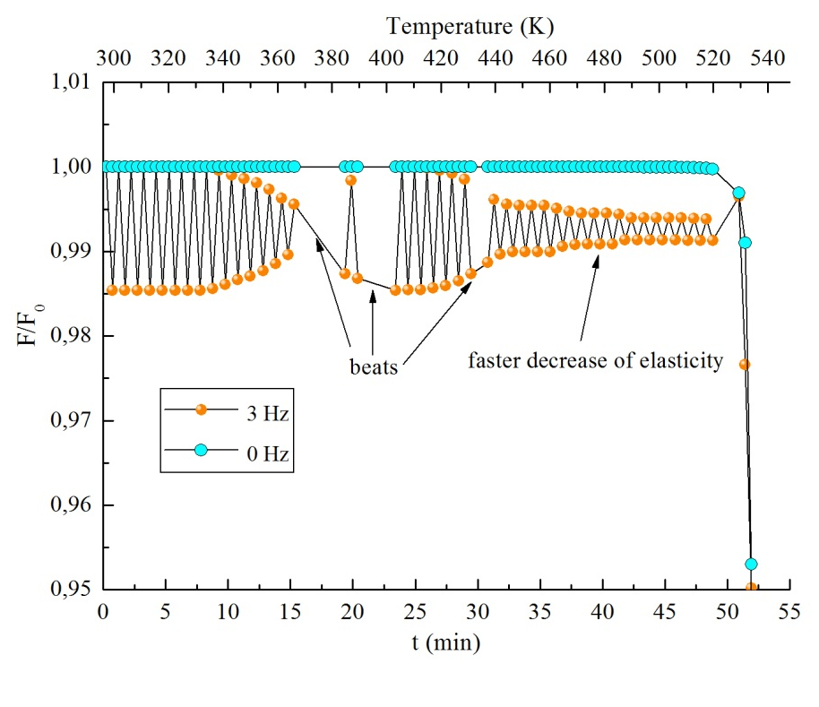
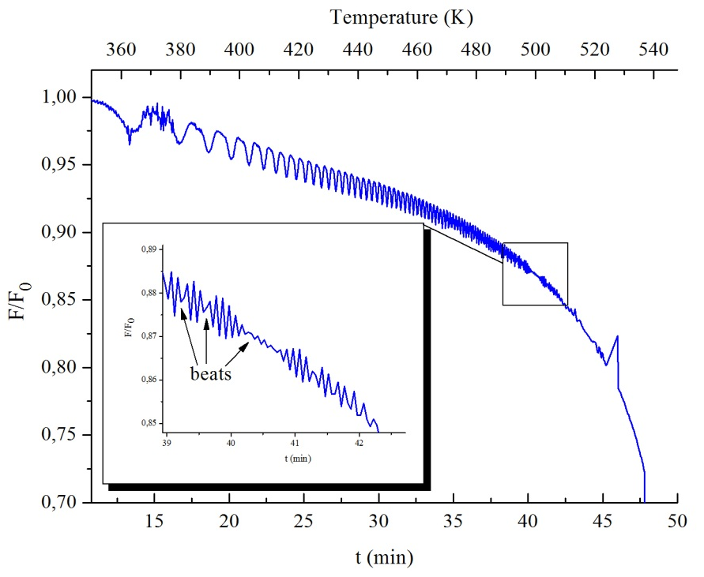
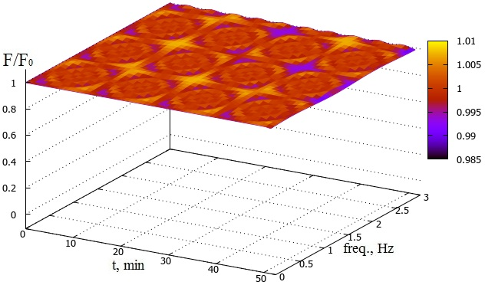
a)
b)
c)
d)
Figure 5. Reaction force relations for Co-based (a) and Al-based amorphous alloys (b,c,d)

Slide 8
Conclusions
Thermal activation and cyclic loading lead to faster deformation of the Cu-Pd-P metallic glassy specimens at a fixed frequency that can be described by a classical mechanical model. Herewith, the occurrence of the wave areas (nodes and antinodes), wherein elastic force is constant(regions of periodic stability), is predictable for the specimen.
Received relations can be used for further investigations not only for DMA but as a basement for comprehensive study in frames of different fields of physics.

Slide 9
Thank you for attention!

