Slide 1


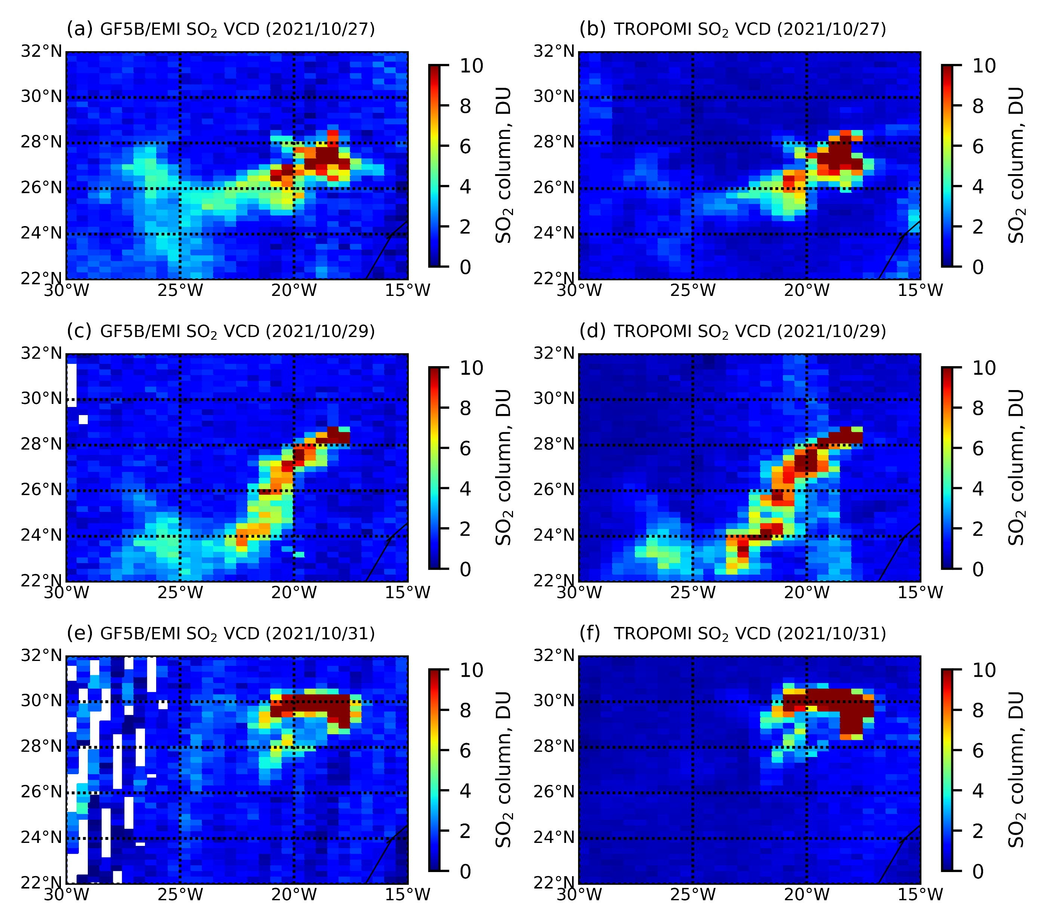
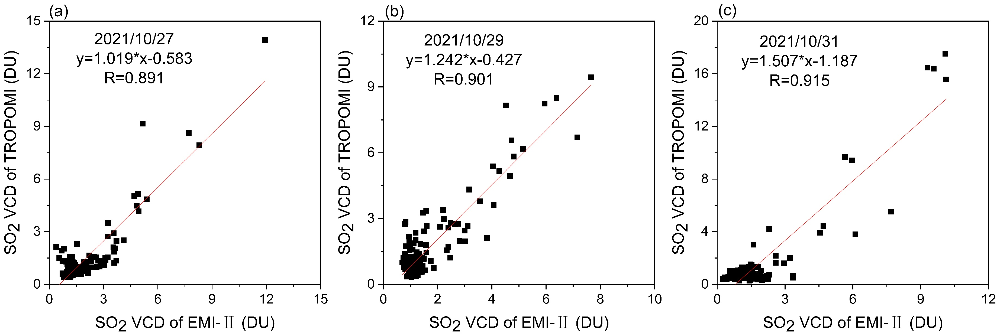
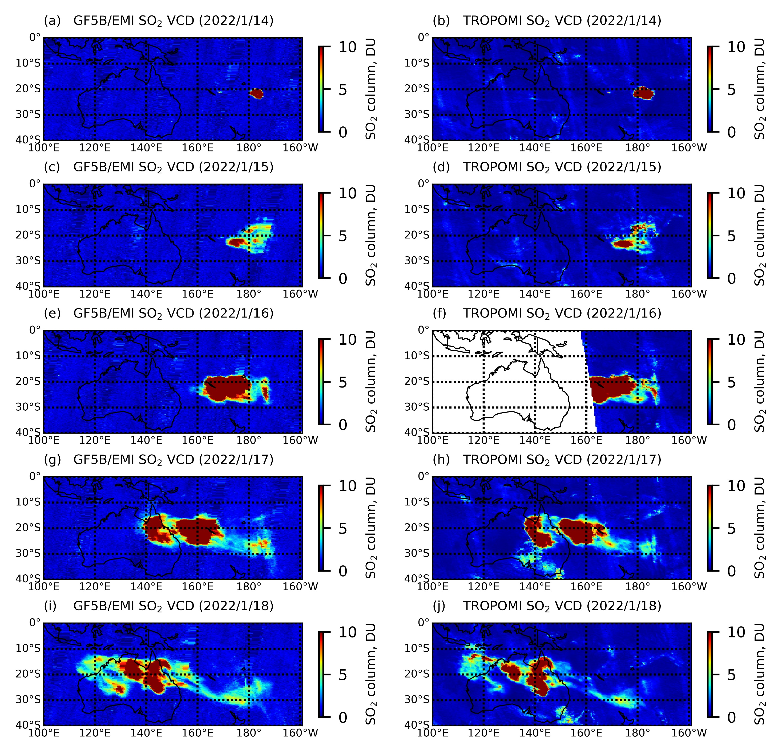
Research on retrieval of sulfur dioxide in volcanic region from EMI-2
Yuanyuan Qian^{1,2}, Fuqi Si¹, Yuhan Luo¹, Haijin Zhou¹ and Taiping Yang¹
¹Key Laboratory of Environmental Optics and Technology, Anhui Institute of Optics and Fine Mechanics, Hefei Institutes of Physical Science, Chinese Academy of Sciences, China
²University of Science and Technology of China, China
Figure1
Introduction: Sulfur dioxide (SO₂) not only affects human health (such as acid rain, respiratory diseases, etc), but is also closely related to climate and environment. SO₂ is an important indicator of air quality, and closely related to volcanic eruptions [1]. The SO₂ vertical column density (VCD) can provide a data basis for tracing the SO₂ pollution caused by the industrial emissions and early warning signals for volcanic eruptions around the world. Therefore, it’s extremely important for us to obtain the daily global SO₂ VCD. In this poster, we report the first volcanic SO₂ VCD results from environmental trace gases monitoring instrument-2 (EMI-2). The transmission of SO₂ plume from Tonga submarine volcano was also firstly reported in this poster.
Results: To validate the retrieved SO₂ VCD results, we compared the EMI-2 SO₂ VCD with that from TROPOMI at La Palma volcano on 27, 29, and 31 October 2021. The SO₂ VCD from EMI-2 shows similar spatial distributions with that from TROPOMI (Figure 1), with the correlation coefficients (R) of 0.891, 0.901 and 0.915 (Figure 2), respectively. In addition, the retrieved SO₂ VCD of EMI-2 was also compared with TROPOMI in Tonga submarine volcano from 14 to 18 January 2022 (Figure 3). As shown in Figure 3, EMI-2 SO₂ VCD shows similar spatial distributions with TROPOMI, and the transmission process (from Tonga island to Australia with east wind) was simultaneously monitored by EMI-2 and TROPOMI.
Figure2
Method: The SO₂ slant column density (SCD) was calculated using the QDOAS software based on the DOAS method [2]. The DOAS method retrieves concentrations of trace gases based on their characteristic absorption and the measured intensity, which is based on the Lambert-Beer’s law. Then, the corresponding SO₂ AMF of the EMI-2 was calculated using the established AMF look up table, which was simulated in the radiative transfer model of SCIATRAN. The SO₂ VCD, the ratio of SCD to AMF ,can be calculated.
Figure3
Conclusion: In this poster, the SO₂ VCD of EMI-2 was firstly retrieved, and validated in volcanic regions. With the La Palma volcano and the Tonga submarine volcano as examples, the SO₂ VCD from EMI-2 presents similar spatial distributions to those from TROPOMI. In addition, the transmission process of SO₂ plume in a volcanic region can be monitored using the retrieved SO₂ VCD from EMI-2. The results of this poster confirm that EMI-2 can monitor SO₂ plume in volcanic regions and realize the early warning of global volcanic eruptions.
Acknowledgment:
We gratefully acknowledge Thomas Danckaert, Caroline Fayt and Michel van Roozendael for providing the QDOAS software and the Institute of Remote Sensing University of Bremen for sharing the SCIATRAN radiative transfer model.
Aims
1. Present the reliable volcanic SO₂ VCD results from EMI-2;
2. Present the transmission of SO₂ plume from Tonga submarine volcano;
3. Validate the capacity of EMI-2 on early warning of global volcano eruptions
Reference:
[1]. Theys N, de Smedt I, van Gent J, et al. Sulfur dioxide vertical column DOAS retrievals from the ozone monitoring instrument: global observations and comparison to ground-based and satellite data. Journal of Geophysical Research, 2015
[2]. Platt, U.; Stutz, J. Differential Optical Absorption Spectroscopy: Principles and Applications; Springer: Berlin/Heidelberg, Germany, 2008

