Slide 1


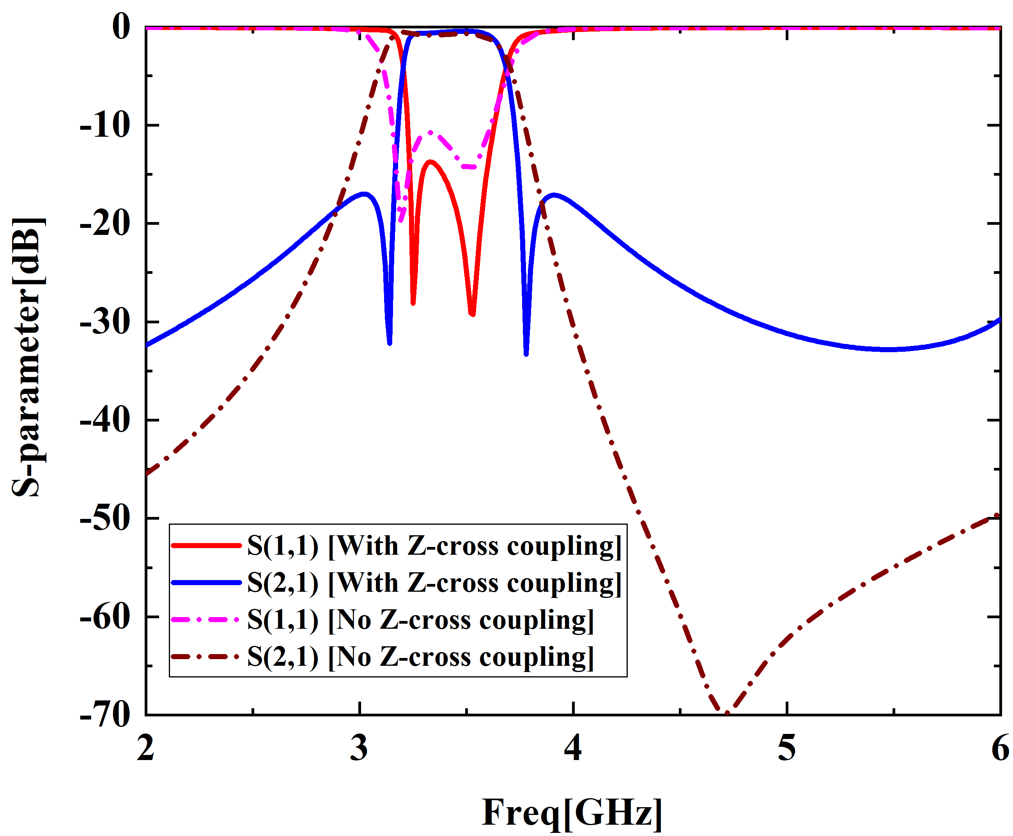
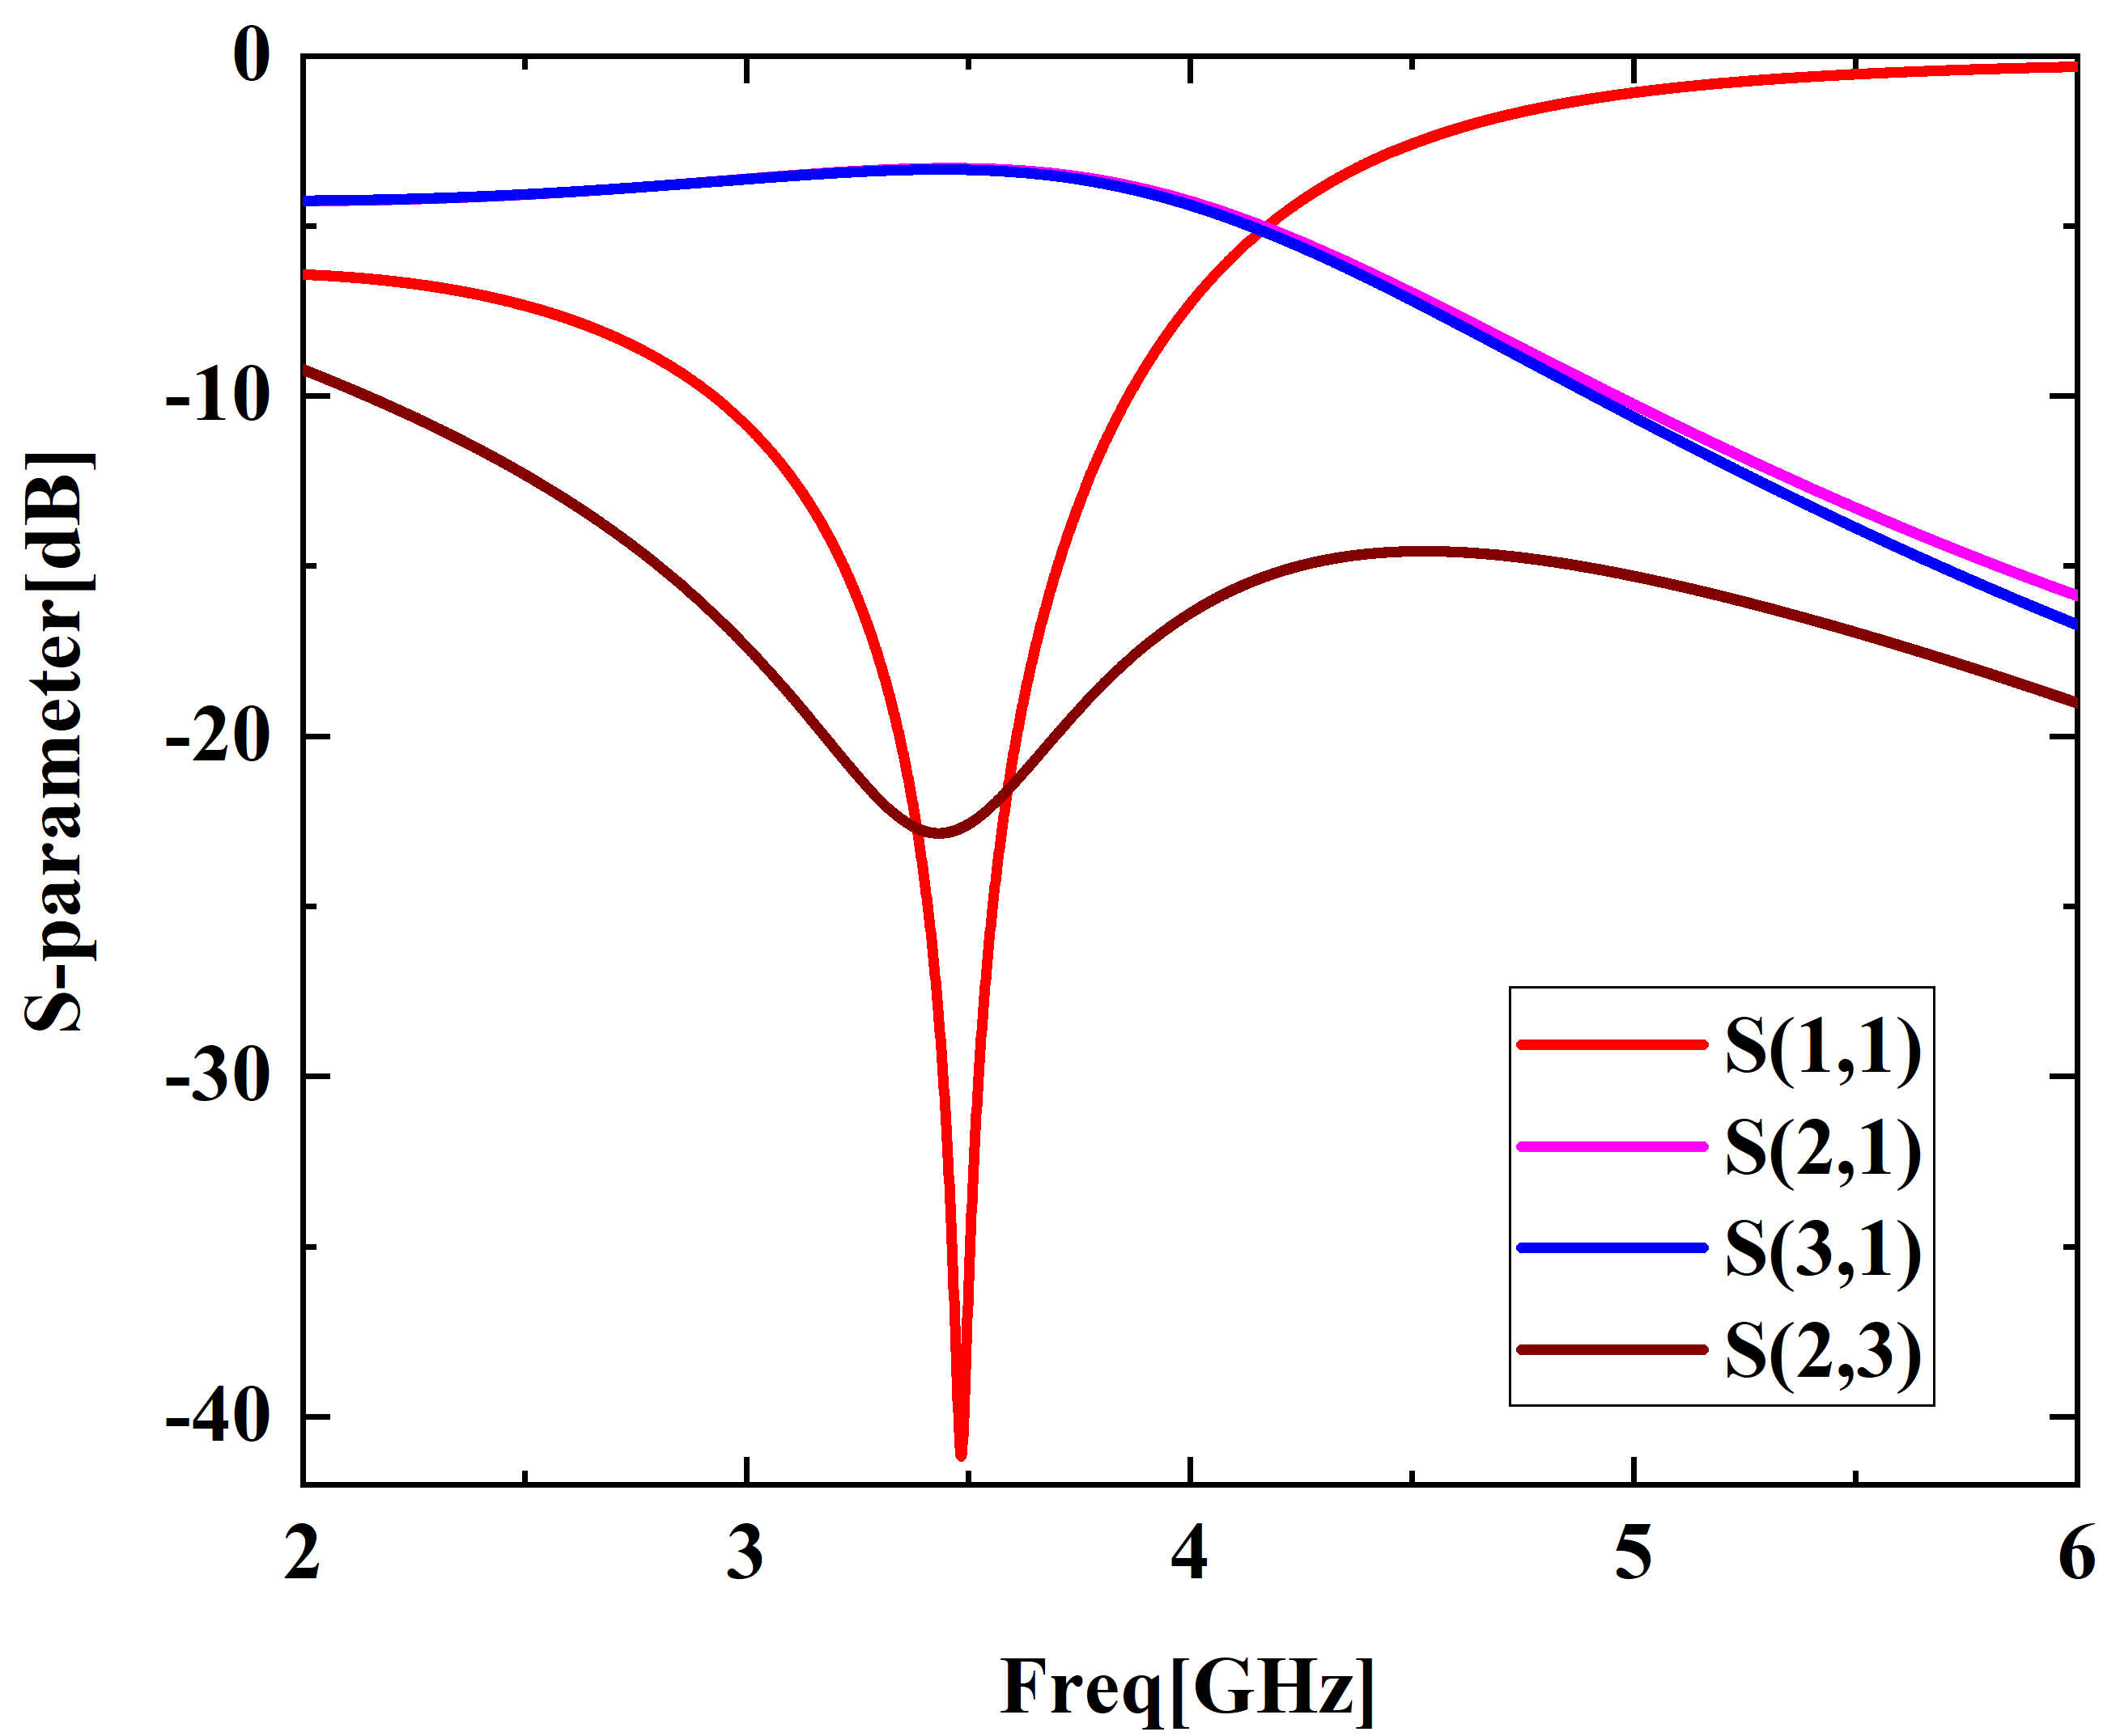
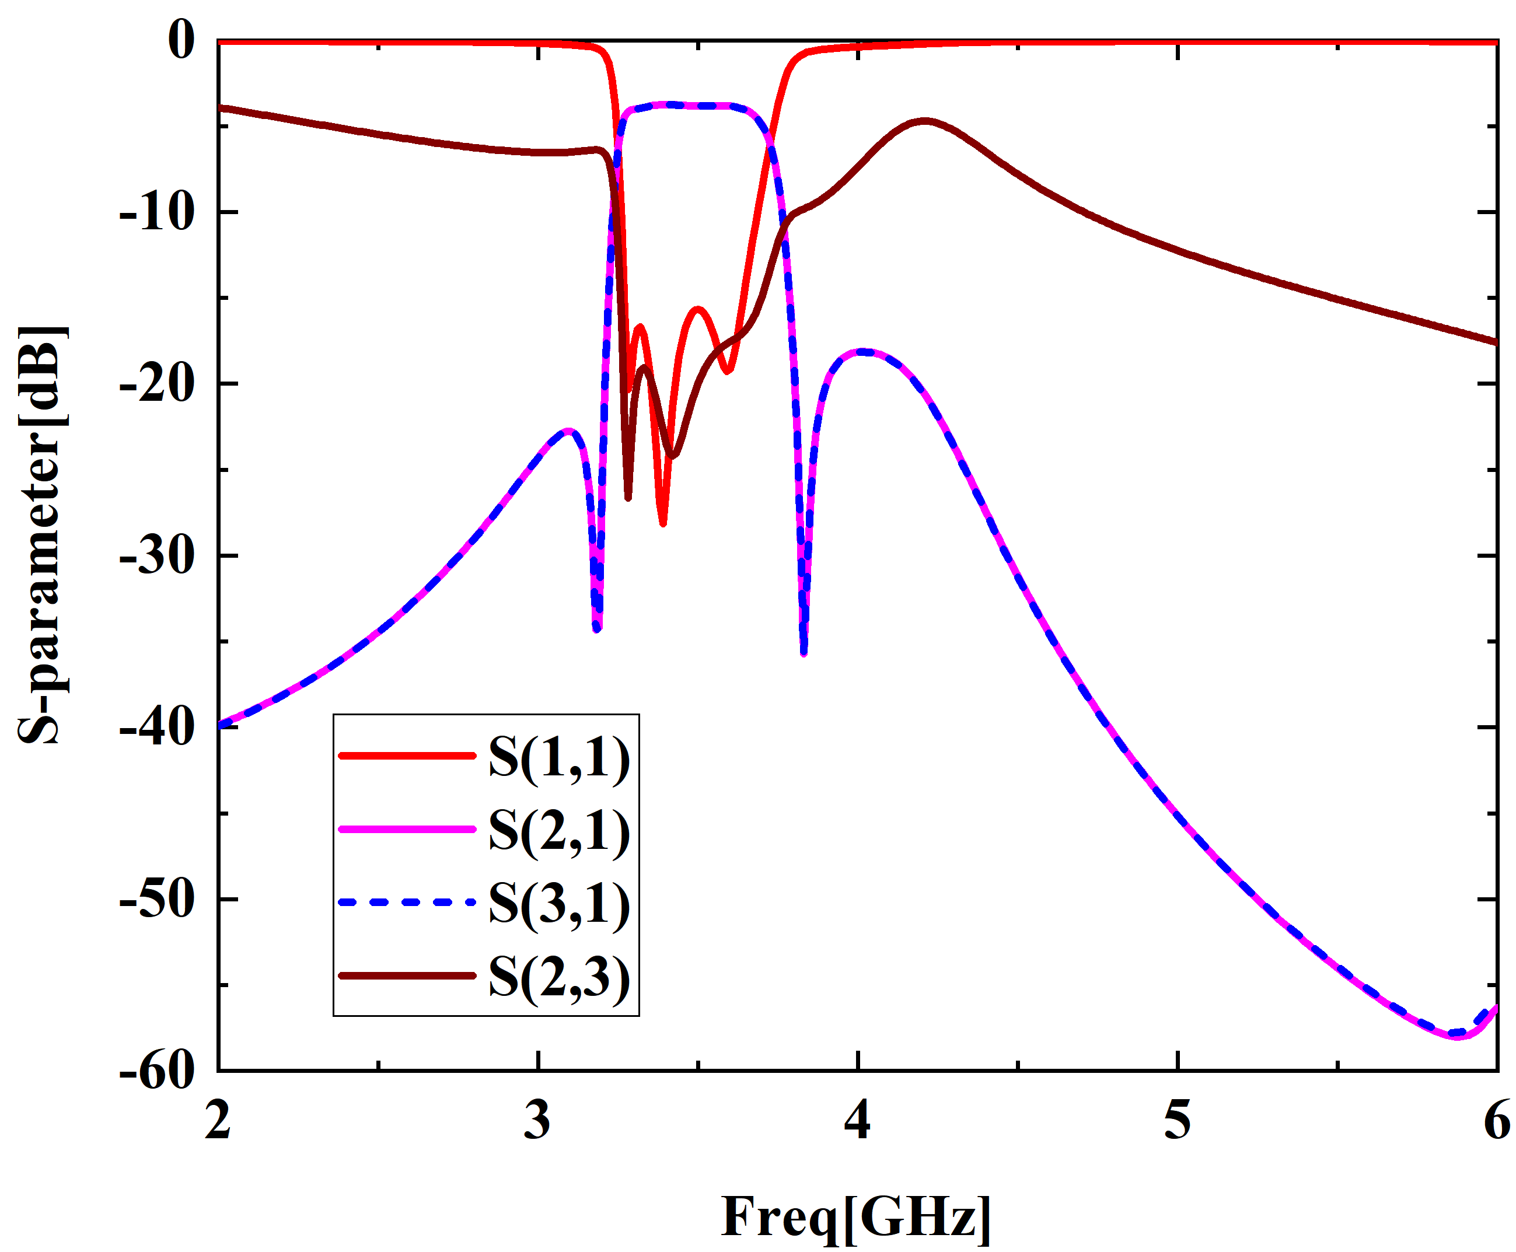
A One-to-Two Filter Power Divider Based on LTCC
Copyright (or ©) [year released] by [name of owner]. All rights reserved.
CNT3137
Yuanyuan Li¹ , Xianliang Wu , Yunfeng Hu, Mengying Dong, Yue Ma, Xiaolei Geng and Rongzhen Fang
ª Key Laboratory of Intelligent Computing and Signal Processing, Ministry of Education, Anhui University, Hefei 230001, China
ABSTRACT
This paper proposes a one-to-two filter power divider based on the LTCC process, and miniaturization is achieved by cascading a bandpass filter and a one-to-two power divider. It is working in 3.3GHz-3.6GHz. The simulation results show that the insertion loss are less than 5dB, the return loss is greater than 15 dB, the isolation is greater than 17 dB, and the out-of-band suppression is greater than 18 dB in 0-3.2GHz and 3.8-6GHz. Its oversize is 10mm×4mm.
DESIGN AND ANALYSIS
Figure 1
Figure 3
Figure 4
Figure 5
The simulation curve of the fourth-order comb-line filter with and without Z shape cross-coupling is shown in Fig.3. The out-of-band suppression can be significantly enhanced by introducing transmission zeros through Z shape.
The S-parameter curve of LTCC power divider is shown in Fig.4.
The S-parameter curve of filter power divider is presented in Figure 5.
The oversize of filter power divider is 10mm×4mm.
Figure 2
The LTCC filter power divider composed of a fourth-order comb-line filter and a Wilkinson power divider in cascade is shown in Fig.1. The filter and the power divider are shown in Fig.2. The dielectric constant of the ceramic dielectric used is 5.9 and its tangent loss angle is 0.0005.
CONCLUSION
In this paper, a one-to-two filter power divider is designed. Based on the characteristics of high integration and low loss of LTCC process, a fourth-order comb-line structure bandpass filter and one-to-two power dividers are cascaded together to reduce the overall size. The simulation results show that the LTCC structure can effectively reduce the size compared with other structures, and the performance of the filter power divider is good.

