Slide 1


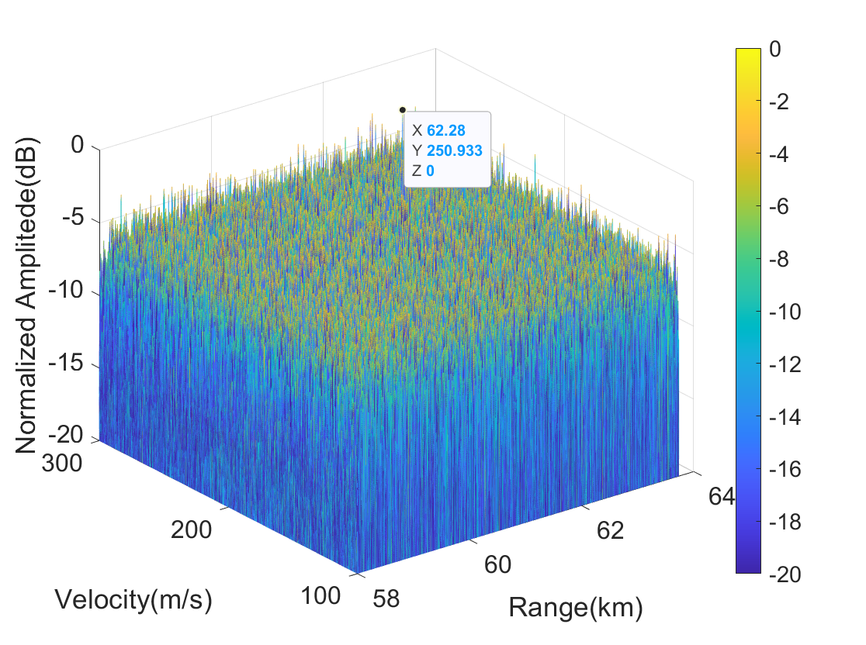
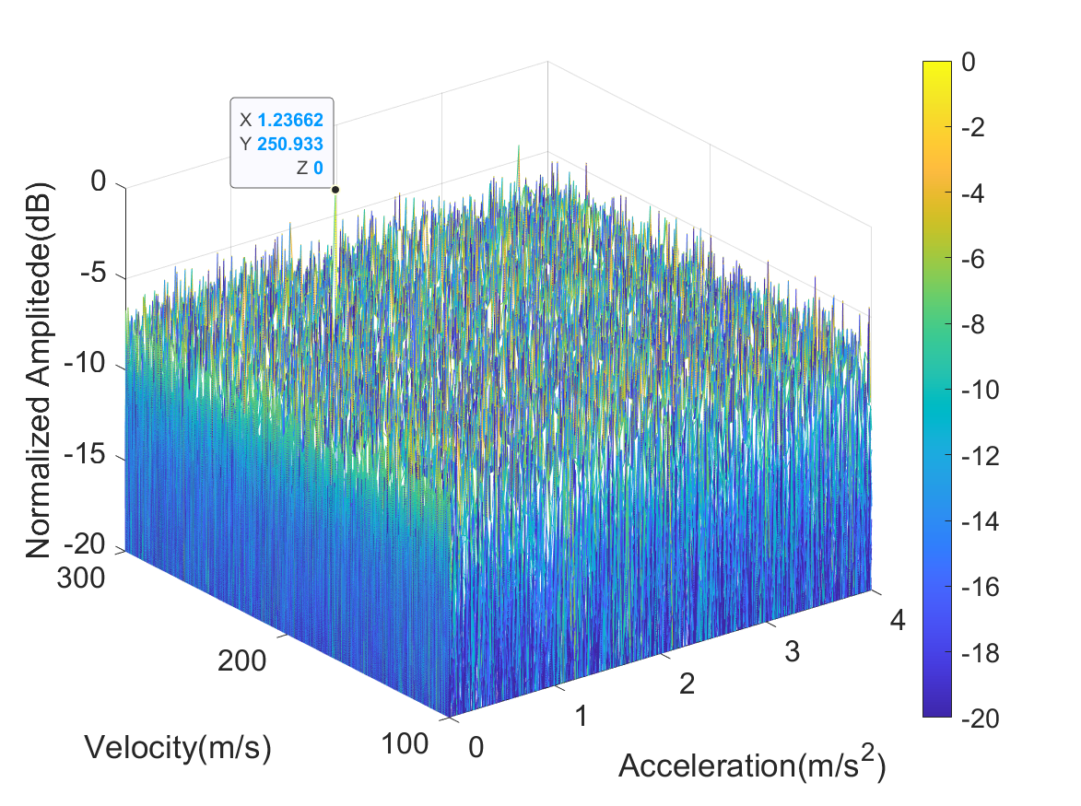
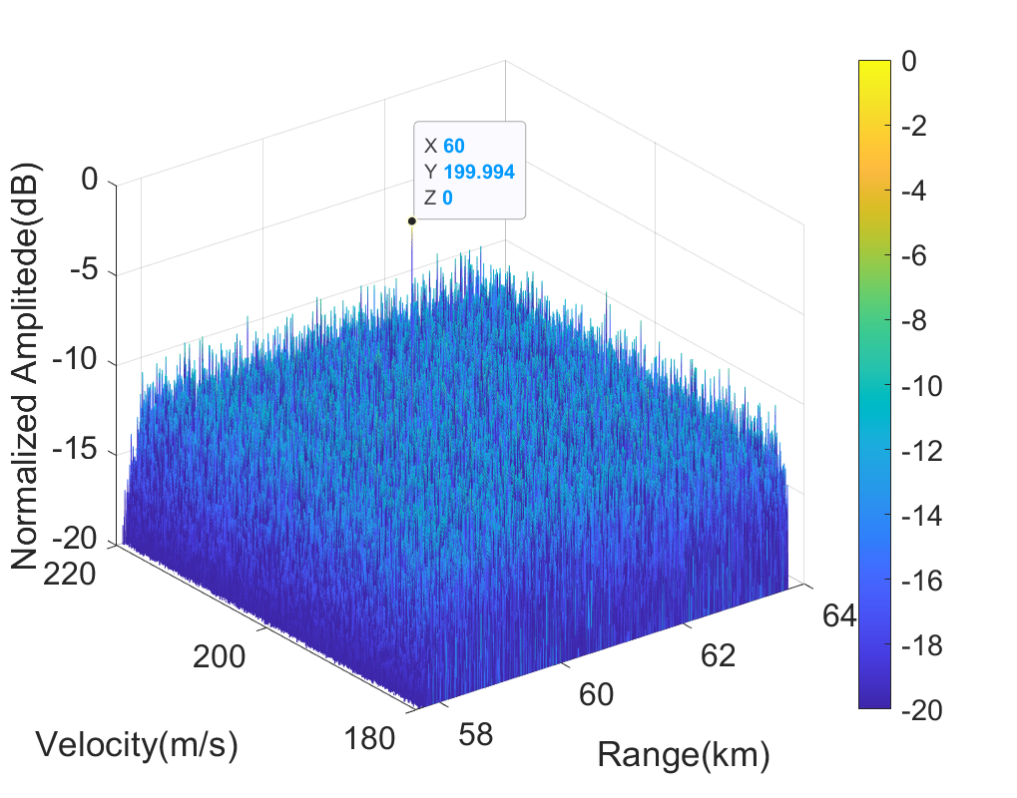
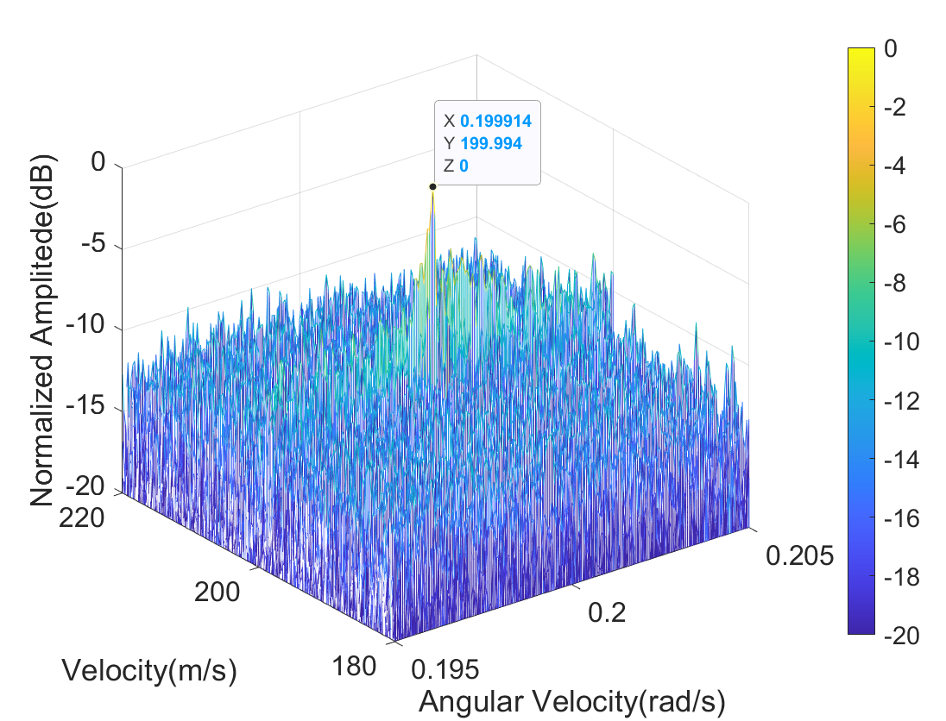
Coherent Accumulation Algorithm for Maneuvering Weak Target Based on Angular-Stepped-GRFT
Copyright (or ©) 2022 by Yuxian SUN. All rights reserved.
CNT3154
Yuxian SUN and Shaoqiang CHANG* and Gang WANG and Zhennan LIANG and Jinpeng GUO and Quanhua LIU
Key Laboratory of Electronic and Information Technology in Satellite Navigation Beijing Institute of Technology, China
Abstract
This paper proposes an improved angular stepped generalized Radon Fourier transform (angular-stepped-GRFT) algorithm for maneuvering weak target detection in synthetic wideband radar. The proposed method can achieve motion parameters estimation for the maneuvering weak target based on stepped frequency signal. On this basis, the motion compensation of maneuvering weak target and range profile focusing method are realized.
Introduction
Small radar cross section (RCS) targets such as aircraft have brought severe threats and challenges to radar detection. At the same time, some small RCS targets also have strong maneuvering ability, which further increases the difficulty of radar detection. How to maintain high precision measurement of the motion parameters of small RCS maneuvering target is one of the difficult problems to be solved urgently by modern radar. To solve the problem of estimating the motion parameters of weak targets, we can increase the observation time to realize the accumulation of target energy for a long time, so as to improve the radar echo signal to noise ratio (SNR) and improve the detection ability of weak targets. In 2011, J. Xu et al. analyzed the relationship between the target ARU phenomenon and the motion parameters of each order, combined the generalized Radon transform and Fourier transform. A long time coherent accumulation algorithm based on generalized Radon Fourier transform (GRFT) is proposed, which has achieved good detection results. In 2021, J Guo et al. combined GRFT with stepped frequency signal and proposed a broadband coherent accumulation method based on stepped generalized Radon Fourier transform (stepped-GRFT). Stepped frequency signal is an important high resolution radar signal, which is widely used in civil and military fields. Stepped-GRFT is limited in that it can only be used for the estimation of radial motion targets. When the weak target maneuvered, stepped-GRFT could not accurately estimate the motion parameters of the target, so that the correct range profile could not be obtained. In order to detect and image maneuvering weak targets in stepped frequency radar, angular-stepped-GRFT is proposed in this paper based on stepped-GRFT, which solves the problem of inaccurate estimation of motion parameters for maneuvering weak targets in stepped-GRFT. The coherent accumulation algorithm based on angular-stepped-GRFT can achieve correct motion compensation and range profile focusing. And effectively improve the SNR of the range profile after coherent accumulation processing.
Simulation Results
Stepped-GRFT
Angular-stepped-GRFT

