Slide 1


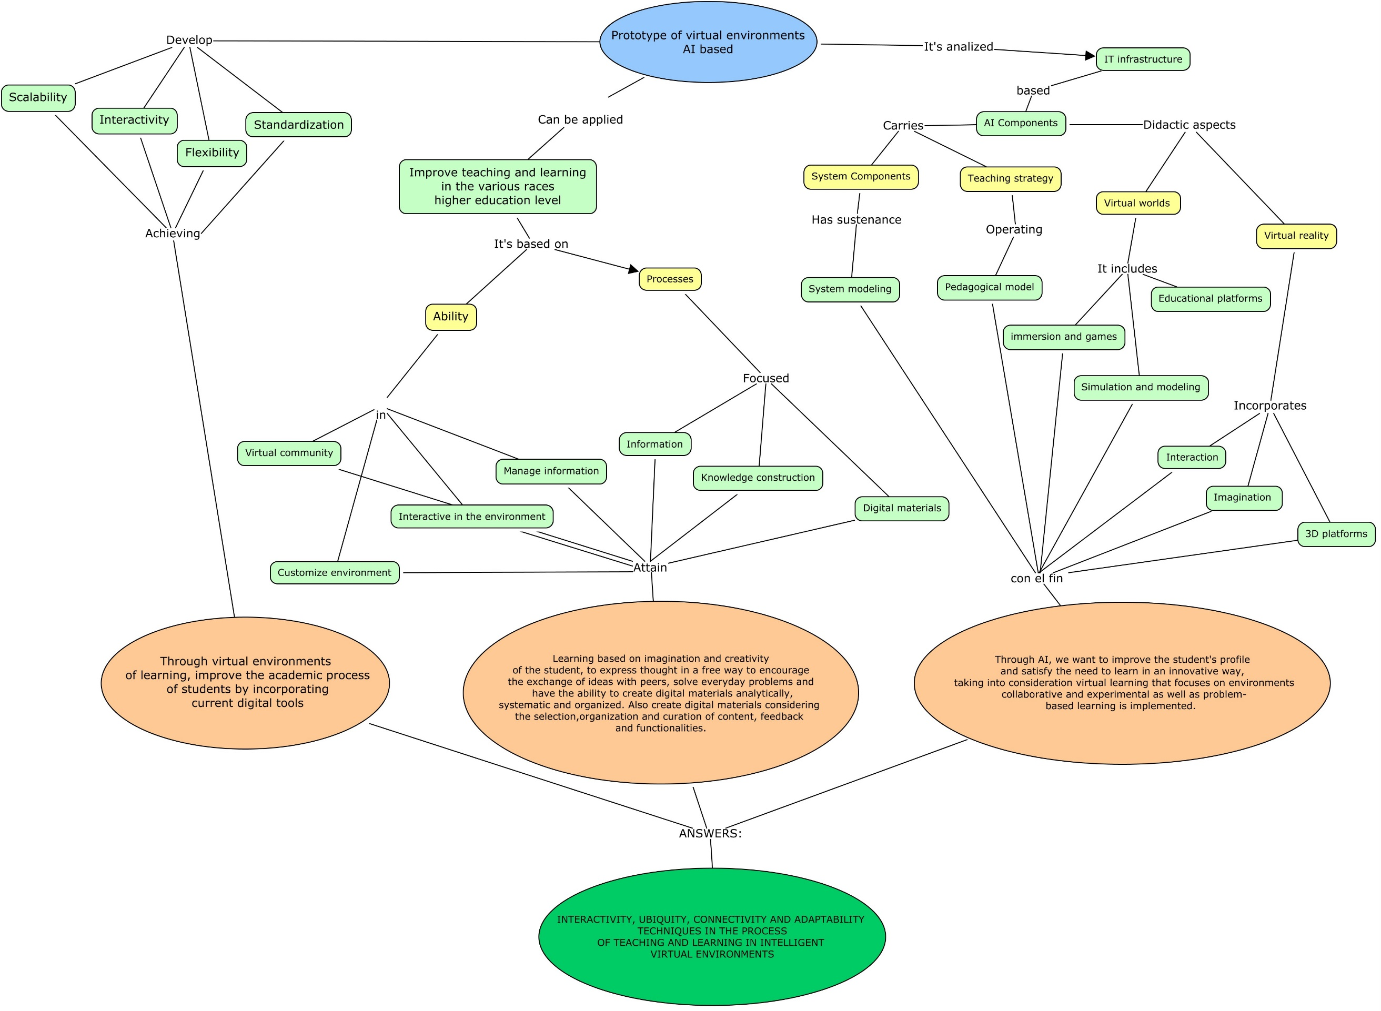
Analysis of Artificial Intelligence Applied in Virtual Learning Environments in Higher Education for Ecuador
Copyright (or ©) [year released] by [name of owner]. All rights reserved.
CNT3157
Segundo Moisés Toapanta Toapanta, Eriannys Zharayth Gómez Díaz, Oscar Marcelo Zambrano Vizuete, Edith Elizabeth Ordoñez Chávez
Research Department, Instituto Tecnológico Superior Rumiñahui
Artificial intelligence in education; today we find ourselves living in a new era which is based on the digital, this is how we are facing great scientific advances in the entire world. The great evolution, technological acceleration and the intensification of skills has forced us to evolve and the educational field has not been the exception, which is why the need has arisen to implement new policies in the educational area where the pedagogical aspect strongly prevails and that it is framed more in this time than in previous times.
The objective of this research is to carry out the analysis of artificial intelligence applied in virtual learning environments for higher education.
In the first instance, in Materials, a search for information was carried out from different sources that allowed defining the situation of virtual environments based on artificial intelligence. Second, in the methods, the steps to achieve the results were defined.
In the first instance, in Materials, a search for information was carried out from different sources that allowed defining the situation of virtual environments based on artificial intelligence. Second, in the methods, the steps to achieve the results were defined.
RESULTS
INTRODUCTION
Proper prototype of virtual environments based on AI
The solutions imposed by the authors of the references [9-19] are valid in virtual environments with their contribution to the investigation; the "Proper prototype of virtual environments based on AI" that is presented consists of defining the characteristics, capabilities, virtual community, IT infrastructure; where knowledge and information and digital material based on the reality of a higher education institution are applied.
The authors thank the collaboration of the authorities of the Instituto Tecnológico Superior Rumiñahui and the Secretary of Higher Education, Science, Technology and Innovation Senescyt.
GOAL
MATERIALS
DISCUSSION
METHODS
ACKNOWLEDGMENTS

