Slide 1
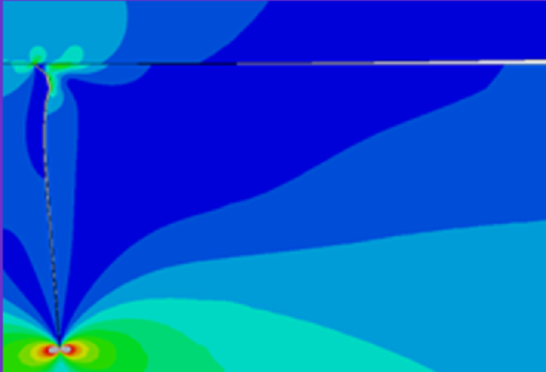

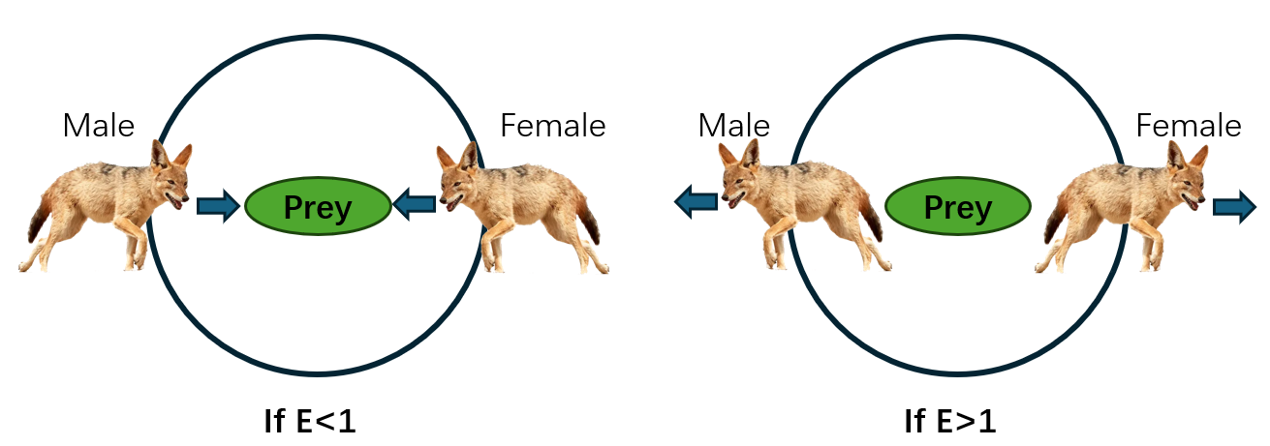
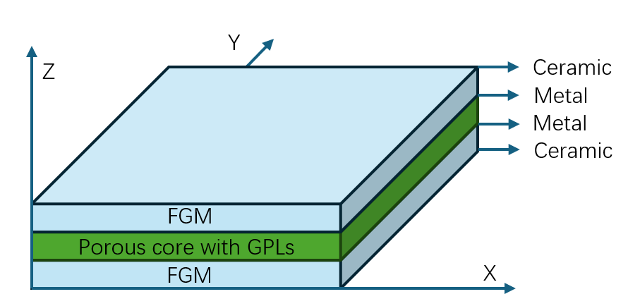
FFW 2024
July 28-31, 2024 Xi'an, China
FFW1385
Design optimization of porous sandwich functionally graded plates reinforced with graphene nanoplatelets based on isogeometric analysis and Ameliorated Golden jackal optimization
Jianfu Bai and Magd Abdel Wahab
Soete Laboratory, Department of Electrical Energy, Metals, Mechanical Constructions, and Systems, Faculty of Engineering and Architecture, Ghent University, Belgium
Background:
Meta-heuristic optimization techniques have the advantages of simplicity, flexibility, derivation-free mechanism, etc., and have been widely used to solve various engineering optimization problems.
An Ameliorated Golden jackal optimization (AGJO) is utilized to alleviate the imbalance between the exploration and exploitation of Golden jackal optimization (GJO) and is a potential algorithm for solving real problems rather than GJO.
Isogeometric Analysis (IGA) utilizes spline functions (such as non-uniform rational B-splines) used in computer-aided design (CAD) to represent geometric shapes. IGA has higher geometric accuracy and reduces repeated meshing compared with traditional finite element analysis. A quasi-three-dimensional model for porous sandwich functionally graded plates reinforced with graphene nanoplatelets was introduced based on IGA.
Research content:
We integrated AGJO into the quasi-three-dimensional IGA finite element model for porous sandwich functionally graded plates to study the effects of multiple parameters on the model's natural vibration frequency, such as the porosity coefficient and the GPL weight fraction. By optimizing the model using AGJO, we identified the maximum first natural vibration frequency and the corresponding parameter values, providing guidance for the optimization design of this model.
f AGJO
Mathematical model of AGJO
Golden jackal optimization is inspired by the foraging behavior of pairs of golden jackals.
A new variant of GJO, named Ameliorated Golden jackal optimization, is proposed using three strategies, including the enhanced movement strategy, the global search strategy, and the multi-angle position update strategy for prey.
Inspiration and Search Strategies of GJO
Enhanced movement strategy
Global search strategy
The flowchart of AGJO
The superiority of BSLO for numerical experiments and real-world problems was demonstrated
Numerical experiments
Six engineering design problems
23 benchmark functions
CEC 2017
Convergence curves
Tension/compression spring
Welded beam
Qualitative analysis
CEC 2006 with constraints
Pressure vessel
Speed reducer
Three-bar truss
Convergence curves
AGJO-based ANN predictive model for composite pipes
Application of AGJO on the quasi-three-dimensional IGA finite element model for porous sandwich functionally graded plates
An isogeometric analysis approach is applied to create the mesh for design and analysis of the IGA finite element model. Effective material properties are calculated by the Halpin-Tsai model and the rule of mixture. A free vibration analysis finite element model is developed based on Non-Uniform Rational B-Splines (NURBS), the Third-order Shear Deformation Theory (TSDT) and AGJO. In this model, AGJO is performed to maximize the first natural frequency by adjusting the design variables, such as the porosity coefficient, the GPL weight fraction and the length-to-thickness ratio.
Porous sandwich functionally graded plates
Control points of 11 cubic elements
Variation of effective Young modulus
Convergence curves

