Slide 1

8th International Conference on Fracture, Fatigue and Wear (FFW 2020)
Ghent, Belgium, August 26-27, 2020, Online conference
1st International Conference on Structural Damage Modelling and Assessment (SDMA 2020)
Ghent, Belgium, August 4-5, 2020, Online conference
Sensitivity of Damping for Diagnostics of Damage in Structures
A. Bovsunovsky, E. Soroka
National Technical University of Ukraine "Igor Sikorsky Kyiv Polytechnic Institute", Kyiv, Ukraine
G.S.Pisarenko Institute for Problems of Strength, Kyiv, Ukraine
1
Notes:
1

Slide 2
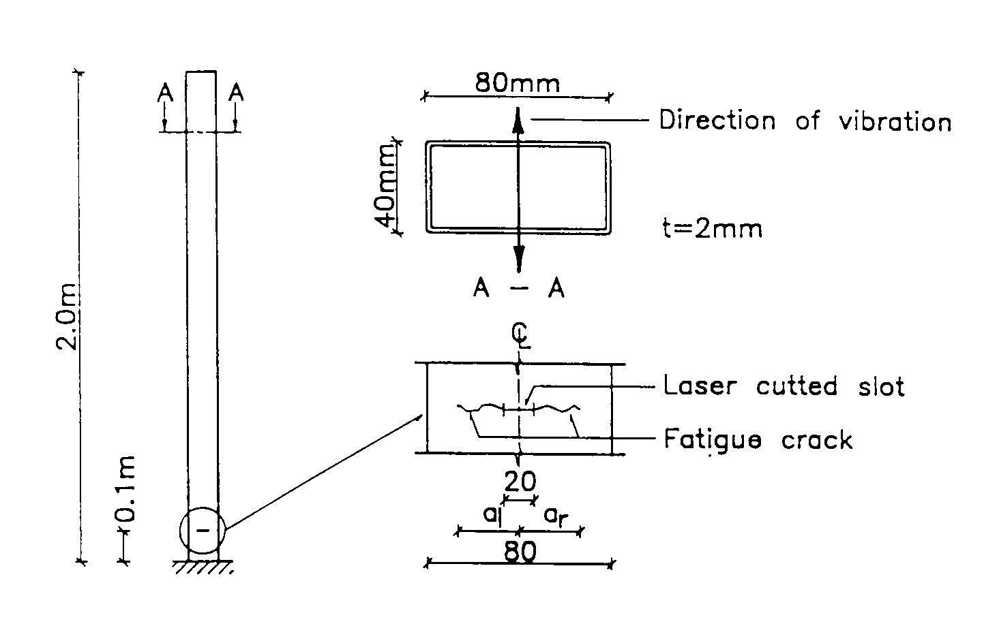
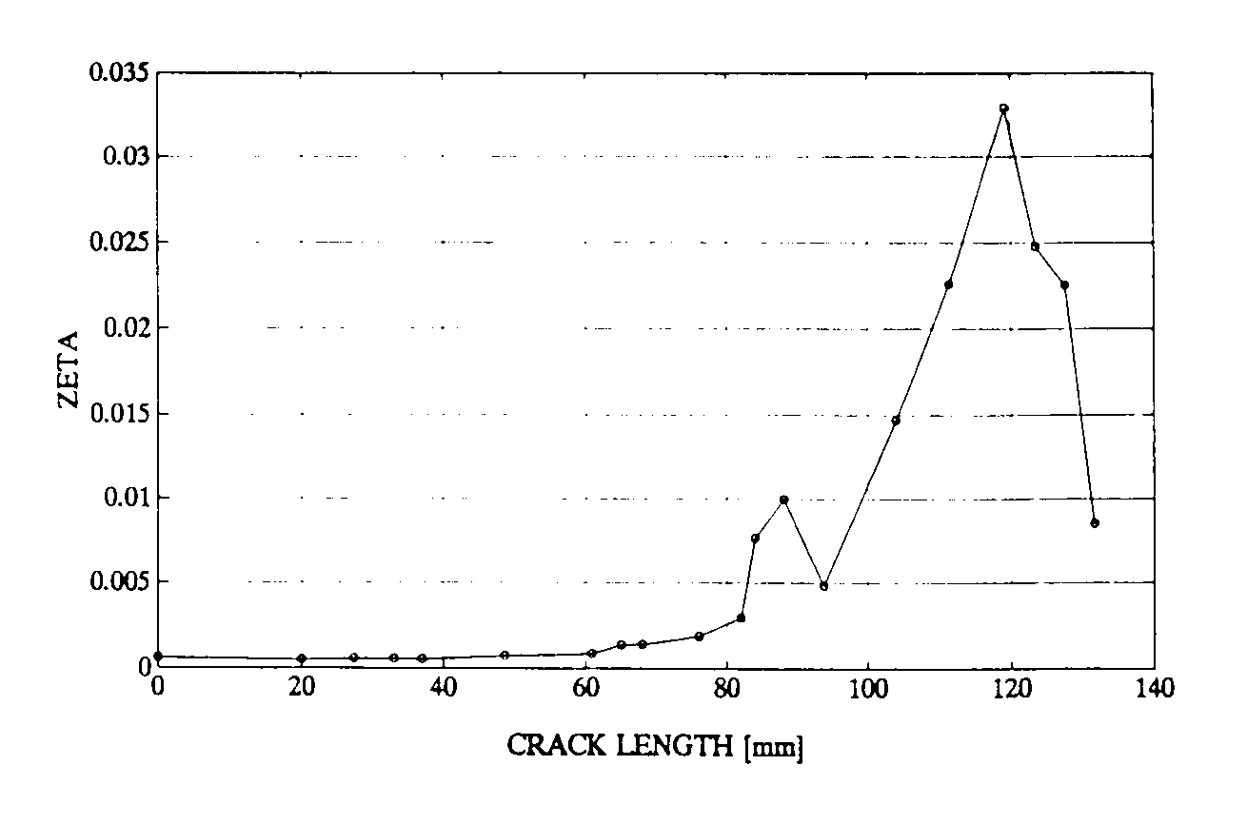
8th International Conference on Fracture, Fatigue and Wear (FFW 2020)
Ghent, Belgium, August 26-27, 2020, Online conference
Damping ratio versus crack length
[ Rytter A, Brincker R, Kirkegaard PH (1992) An experimental study of the modal parameters of a cantilever. Fracture & Dynamics. Paper No.37, Department of Building Technology and Structural Engineering, University of Aalborg, Denmark, 76 p. ]
2
Notes:
2

Slide 3
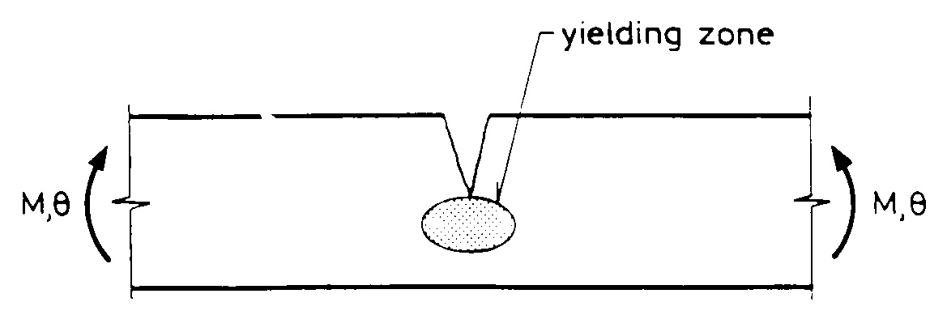
8th International Conference on Fracture, Fatigue and Wear (FFW 2020)
Ghent, Belgium, August 26-27, 2020, Online conference
[ Bovsunovsky AP (2004) The mechanisms of energy dissipation in the non-propagating fatigue cracks in metallic materials. Eng Fract Mech 71: 2271–2281 ]
3
Notes:
3

Slide 4
8th International Conference on Fracture, Fatigue and Wear (FFW 2020)
Ghent, Belgium, August 26-27, 2020, Online conference
AIM OF THE WORK
to determine conditions under which damping characteristics are sensitive enough for the reliable diagnostics of damage in structures.
4
Notes:
4

Slide 5
8th International Conference on Fracture, Fatigue and Wear (FFW 2020)
Ghent, Belgium, August 26-27, 2020, Online conference
Simply supported beam with an edge crack
5
Notes:
5

Slide 6
8th International Conference on Fracture, Fatigue and Wear (FFW 2020)
Ghent, Belgium, August 26-27, 2020, Online conference
Analytical model for the determination of damping
for cracked structure
(1)
(2)
(3)
(4)
(5)
6
Notes:
6

Slide 7

8th International Conference on Fracture, Fatigue and Wear (FFW 2020)
Ghent, Belgium, August 26-27, 2020, Online conference
Geometrical and mechanical properties of the beam
Length of beam – L = 0.2 … 2 m.
Height, width, and diameter of beam – h = b = d = 0.02 m.
Slenderness ratio – L/h = 10 … 100.
Initial level of damping – δ = 0.002 ... 0.2.
Stress amplitude – σ =10 MPa.
7
Notes:
7

Slide 8

8th International Conference on Fracture, Fatigue and Wear (FFW 2020)
Ghent, Belgium, August 26-27, 2020, Online conference
Relative change of damping – prismatic beam
8
Notes:
8

Slide 9

8th International Conference on Fracture, Fatigue and Wear (FFW 2020)
Ghent, Belgium, August 26-27, 2020, Online conference
Relative change of frequency – prismatic beam
9
Notes:
9

Slide 10

8th International Conference on Fracture, Fatigue and Wear (FFW 2020)
Ghent, Belgium, August 26-27, 2020, Online conference
Relative change of damping – prismatic beam
10
Notes:
10

Slide 11

8th International Conference on Fracture, Fatigue and Wear (FFW 2020)
Ghent, Belgium, August 26-27, 2020, Online conference
11
Notes:
11

Slide 12
8th International Conference on Fracture, Fatigue and Wear (FFW 2020)
Ghent, Belgium, August 26-27, 2020, Online conference
δ | L/h, L/d | α_{det}, γ_{det} ( δc/δ=1.2 ) | α_{det}, γ_{det} ( fc/f=0.95 )
0.002 | 10 | 0.040 | 0.228
 | 20 | 0.082 | 0.315
 | 50 | 0.210 | 0.457
 | 100 | 0.354 | >0.5
0.02 | 10 | 0.351 | 0.228
 | 20 | 0.497 | 0.315
 | 50 | >0.5 | 0.457
 | 100 | >0.5 | >0.5
0.2 | 10 | >0.5 | 0.228
 | 20 | >0.5 | 0.315
 | 50 | >0.5 | 0.457
 | 100 | >0.5 | >0.5
12
Notes:
12

Slide 13

8th International Conference on Fracture, Fatigue and Wear (FFW 2020)
Ghent, Belgium, August 26-27, 2020, Online conference
ΔU_{c} – energy dissipated in crack;
U – maximal strain energy;
δ – logarithmic decrement of vibration;
κ – relative error of experiment.
13
Notes:
13

Slide 14
8th International Conference on Fracture, Fatigue and Wear (FFW 2020)
Ghent, Belgium, August 26-27, 2020, Online conference
FACTORS TO ASSESS DAMPING CHANGE AS APPLIED FOR DAMAGE DETECTION
- crack size;
- crack location;
- type of crack;
- type of vibration (axial, bending, torsional);
- damping characteristic of intact structure;
- slenderness ratio.
14
Notes:
14

Slide 15
8th International Conference on Fracture, Fatigue and Wear (FFW 2020)
Ghent, Belgium, August 26-27, 2020, Online conference
CONCLUSIONS
the fracture mechanics based procedure is developed to calculate the change of damping of bending and axial vibrations for the simply supported prismatic and cylindrical beam with an edge crack of mode I;
application of this procedure made it possible to identify the condition under which the change of structure’s damping is sensitive enough for the diagnostics of crack;
the sensitivity of damping to the presence of damage is inversely proportional to the level of damping of the intact structure and directly proportional to the structure’s stiffness and to the level of stresses in the damaged area.
15
Notes:
15

Slide 16
8th International Conference on Fracture, Fatigue and Wear (FFW 2020)
Ghent, Belgium, August 26-27, 2020, Online conference
THANK YOU
FOR ATTENTION !
16
Notes:
16

